Slide 1
不作外部展示文档 移动机器人原理

Slide 2
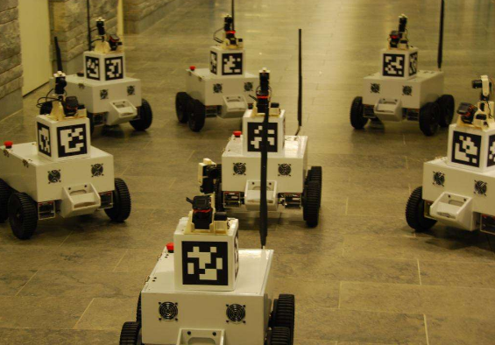
自主运动的基本问题
我在什么地方？——定位
周围环境是什么样子？——建图
我怎么去目的地？——路径规划
什么条件下去哪个目的地？ ——调度

Slide 3
综述
第一次报告：基础知识-高维高斯分布，位姿的表达（旋转矩阵，角轴，欧拉角，四元数），李群与李代数，轮式运动学（差分轮，全向轮，麦克纳姆轮），传感器模型（相机，双目相机，激光雷达），滤波器（BF，KF，EKF，UKF，EIF，PF）
第二次报告：非线性优化、SLAM、蒙特卡洛定位
第三次报告：导航

Slide 4
PART 1
Gaussian Distribution

Slide 5
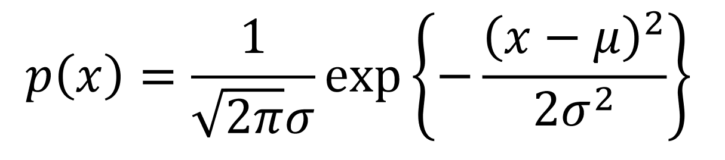
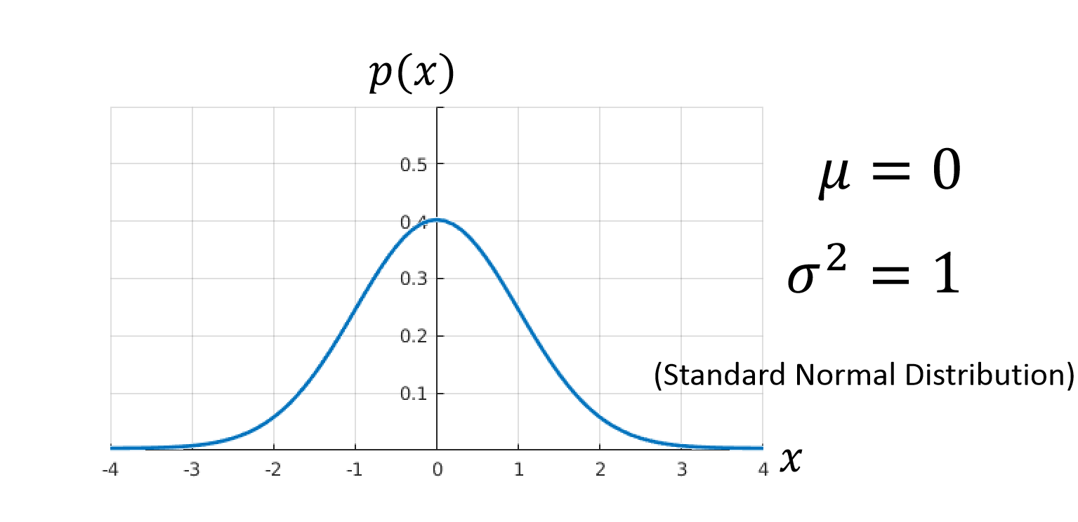
Gaussian Distribution

Slide 6
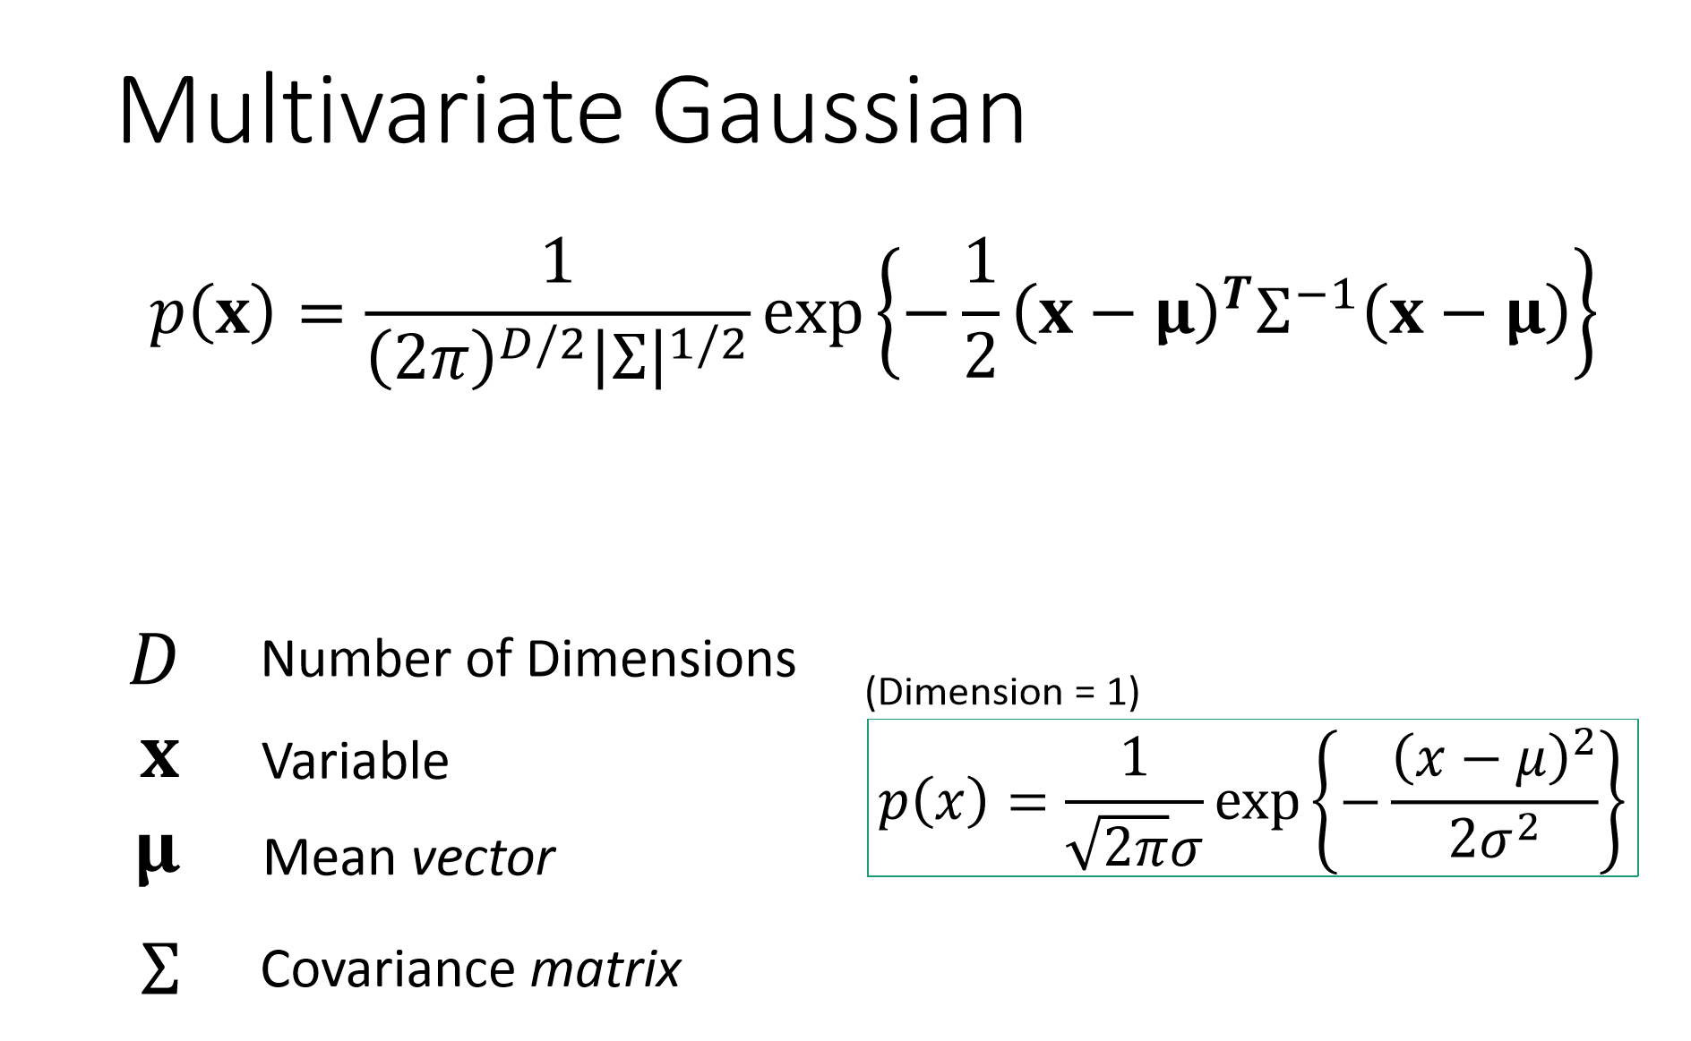
Gaussian Distribution

Slide 7
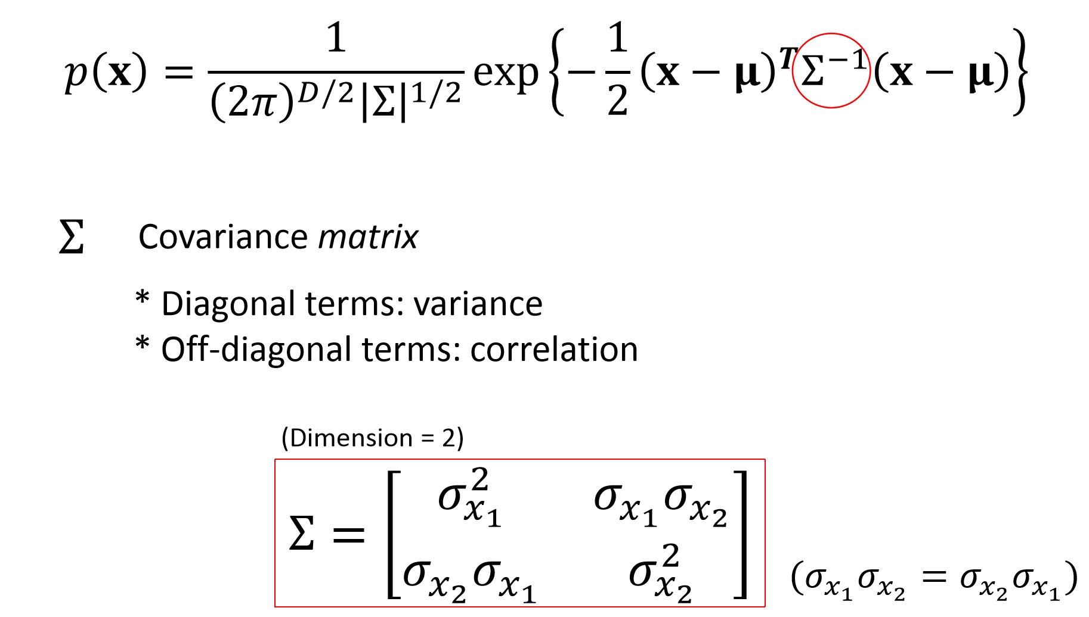

Gaussian Distribution

Slide 8
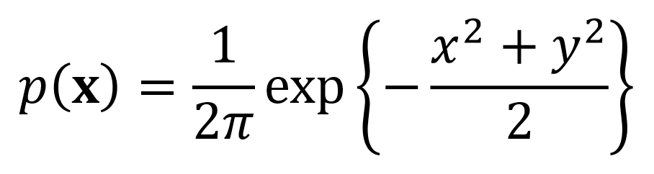
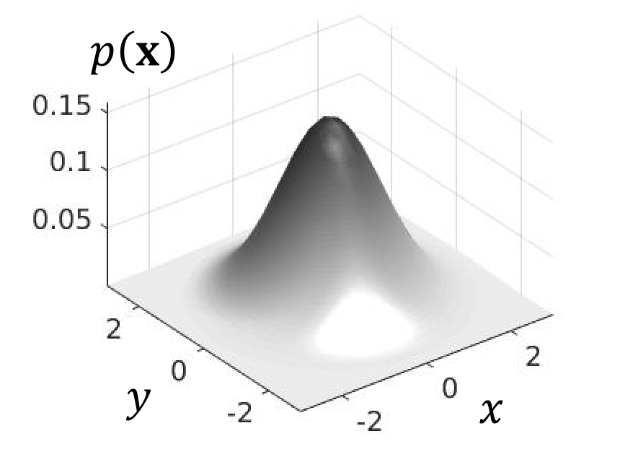
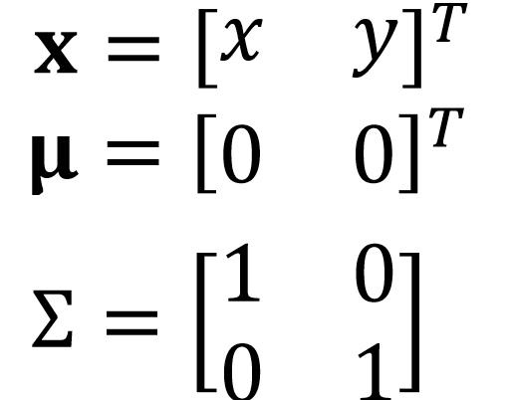
Gaussian Distribution

Slide 9
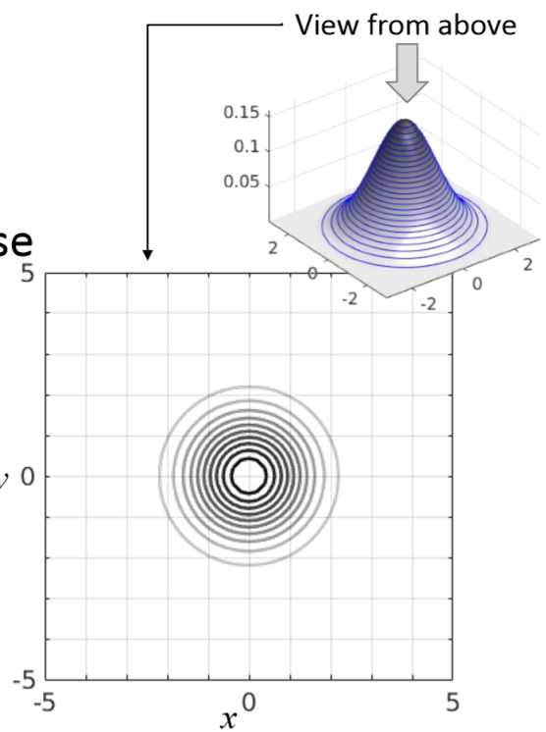
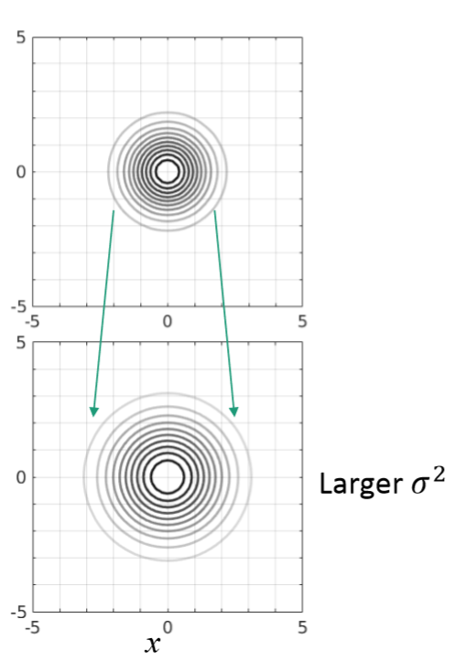
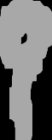
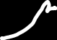
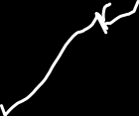
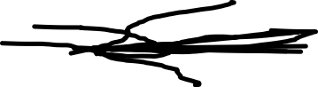
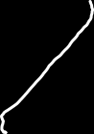
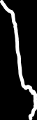
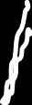
Gaussian Distribution

Slide 10
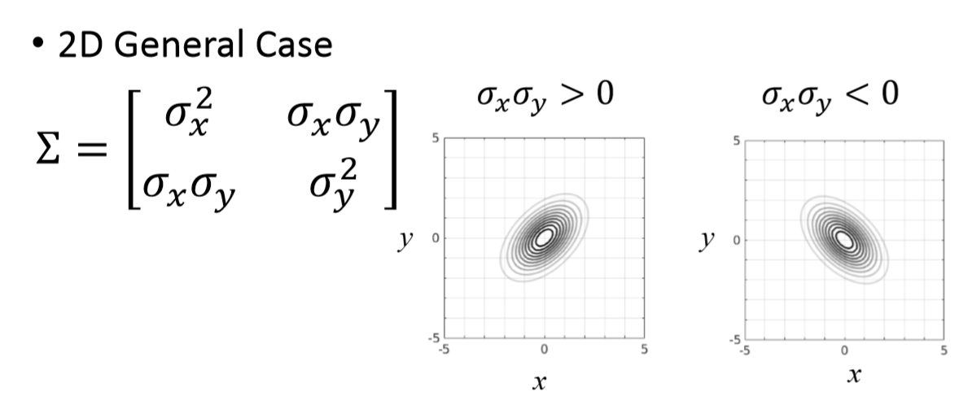
Gaussian Distribution

Slide 11
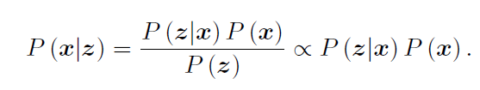
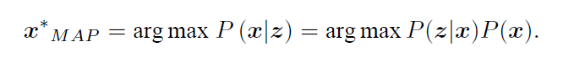
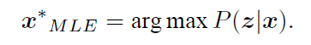
MLE & MAP
Bayer’s rules
Maximize a Posterior，MAP
Maximize Likelihood Estimation, MLE

Slide 12
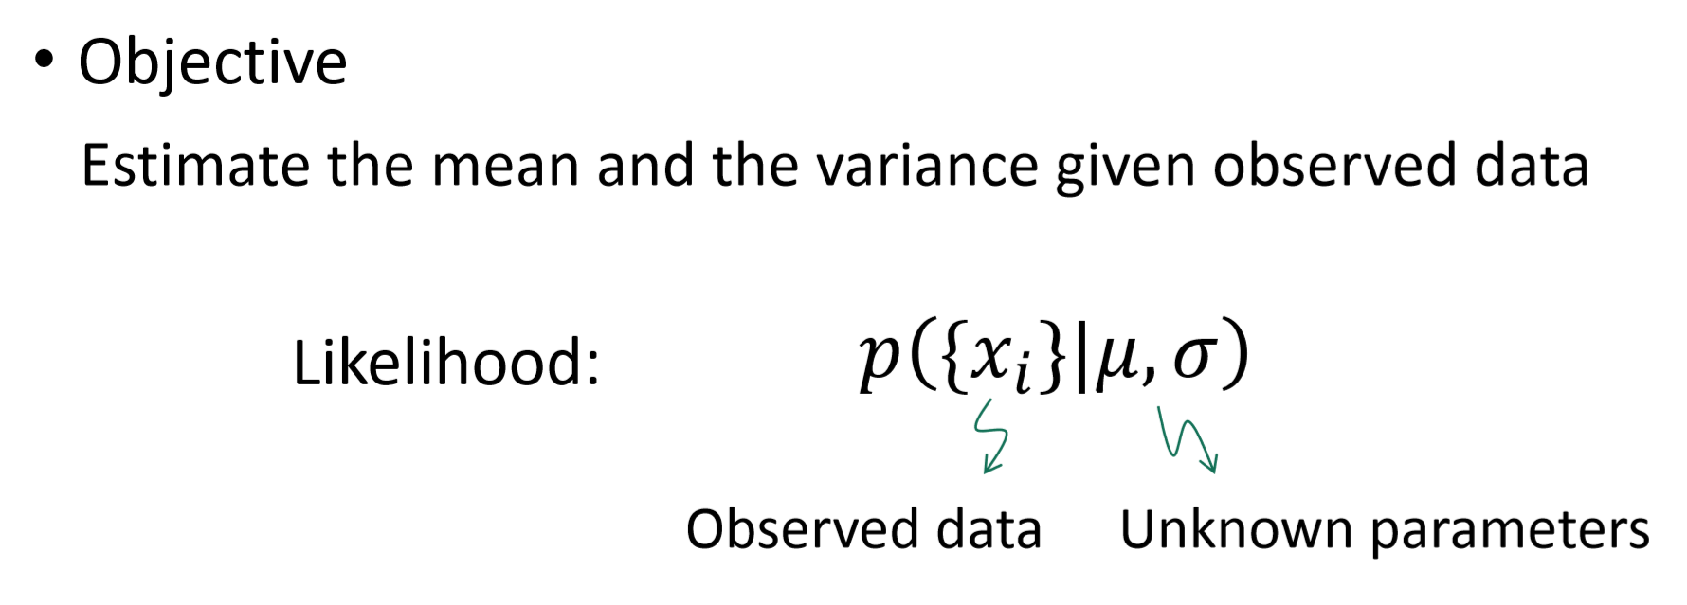
Maximum Likelihood Estimate of Multivariate Gaussian Parameters

Slide 13
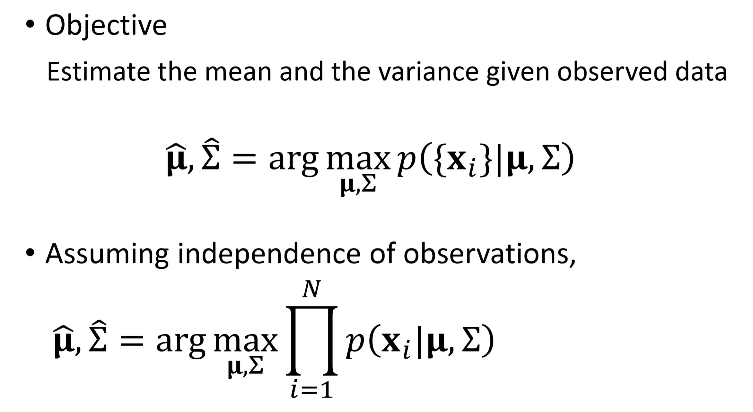
Maximum Likelihood Estimate of Multivariate Gaussian Parameters

Slide 14
Maximum Likelihood Estimate of Multivariate Gaussian Parameters

Slide 15
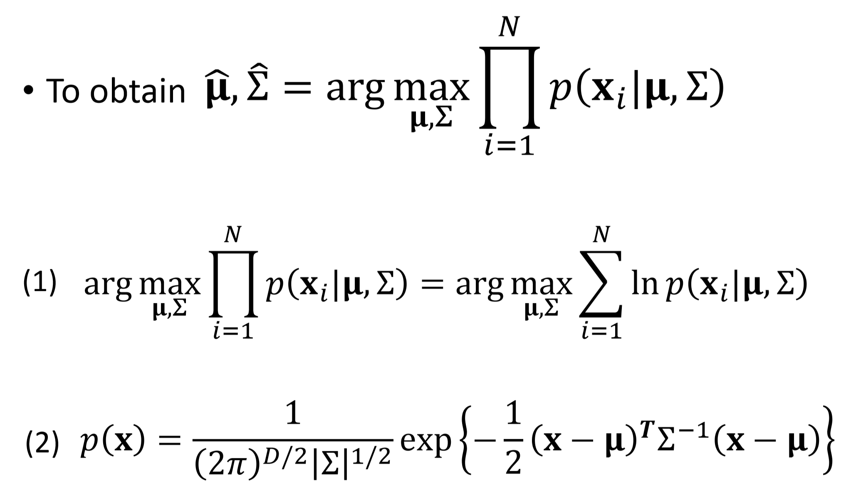

Slide 16
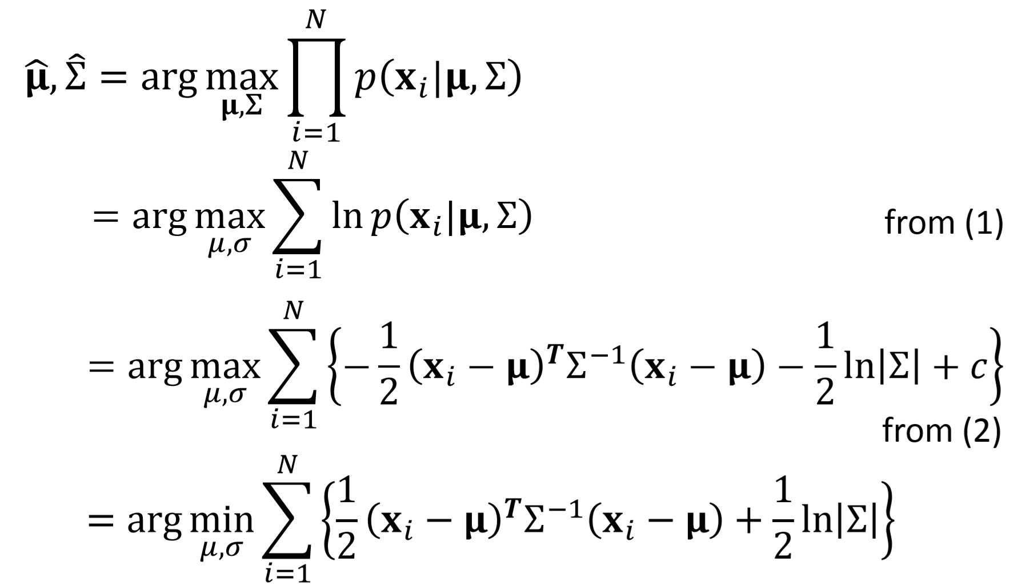

Slide 17
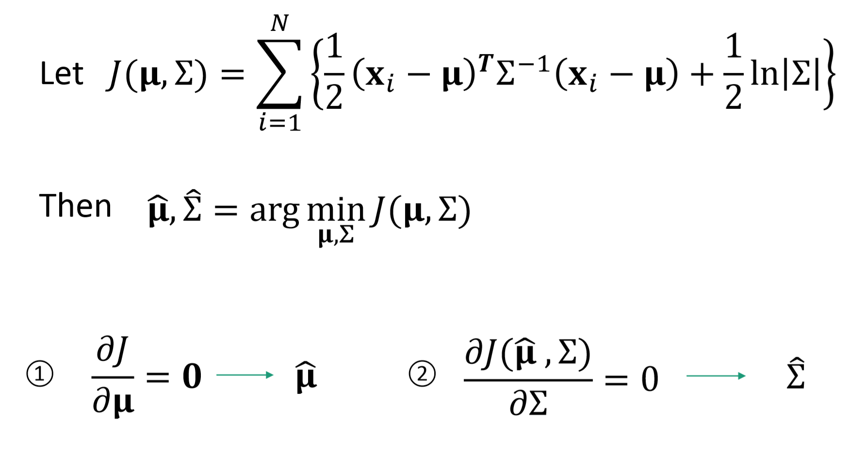

Slide 18
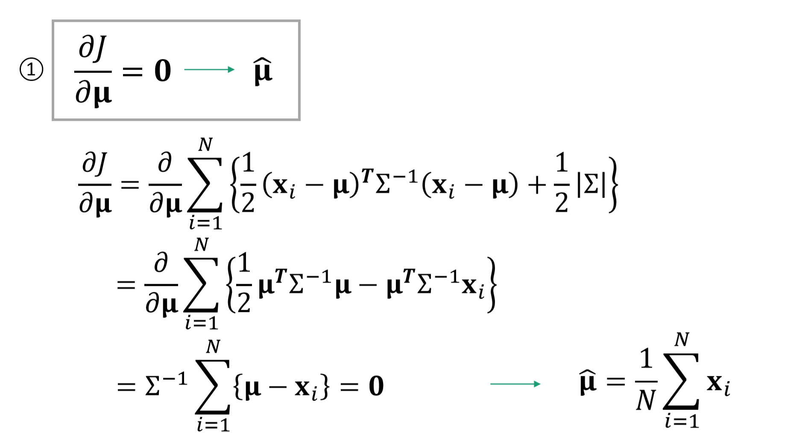

Slide 19
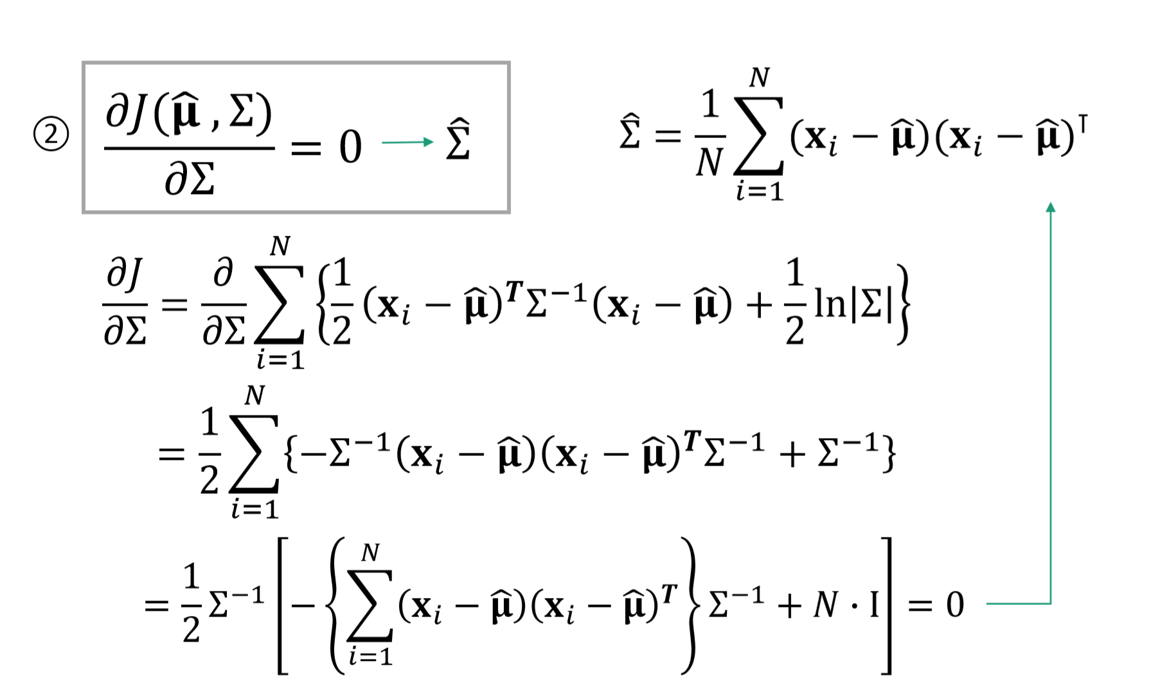

Slide 20
PART 2
Three-Dimensional Geometry

Slide 21
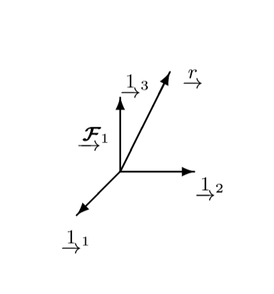
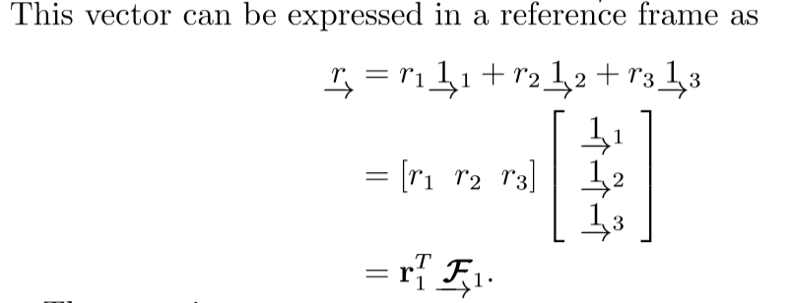
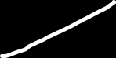
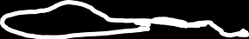
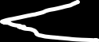
Reference Frames

Slide 22
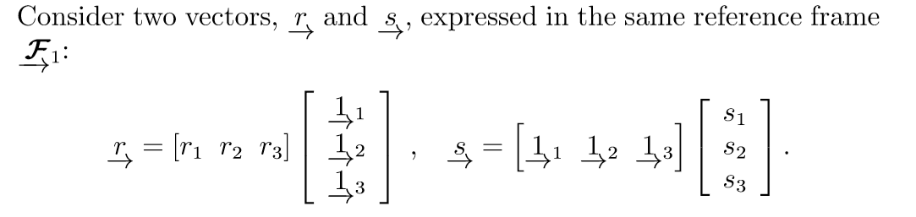
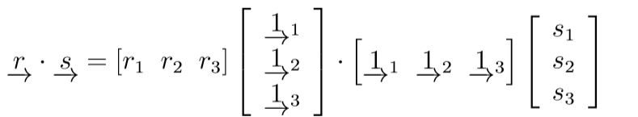
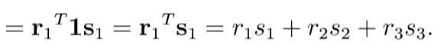
Dot Product

Slide 23
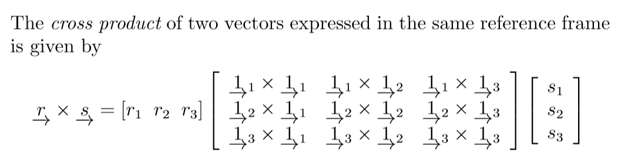
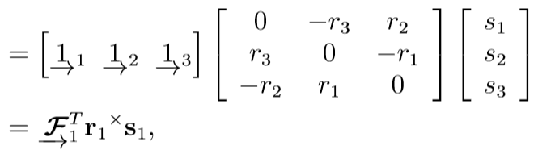


Cross Product

Slide 24
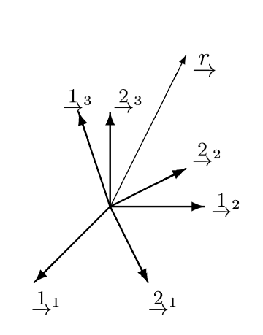
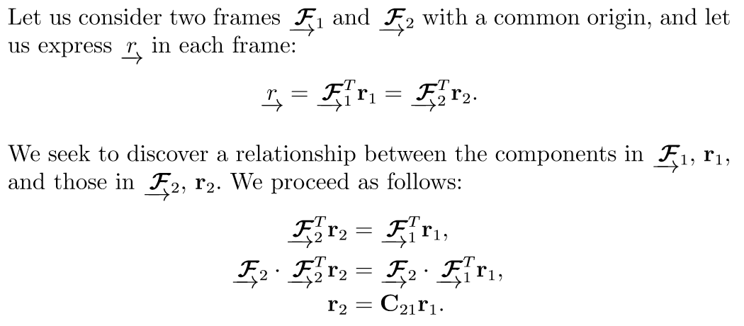
Rotations

Slide 25
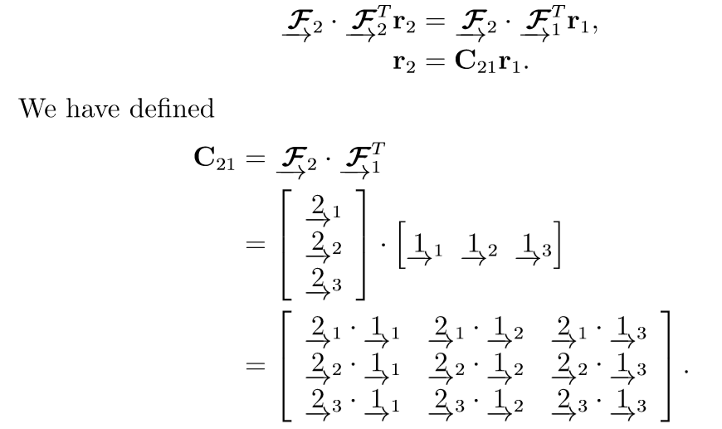


Rotations

Slide 26
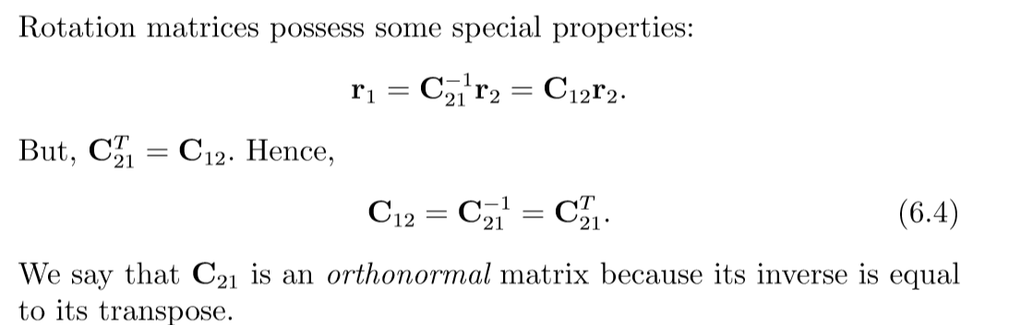


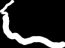
Rotations

Slide 27
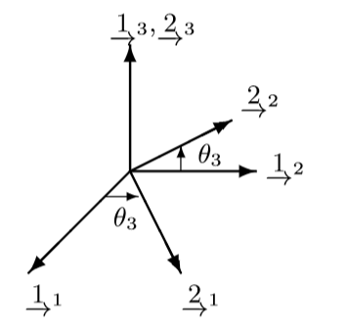
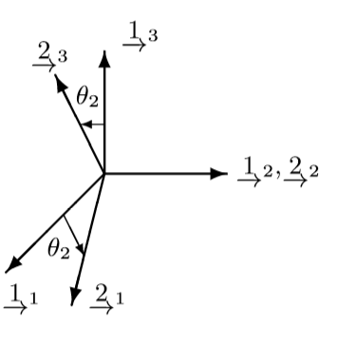
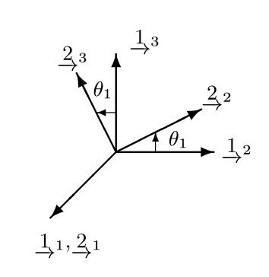
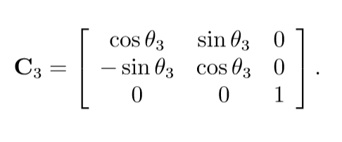
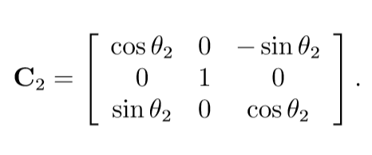
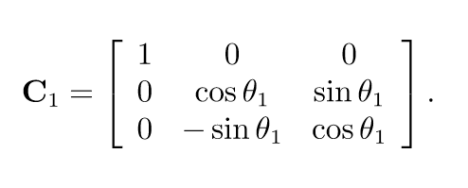
Principal Rotations

Slide 28
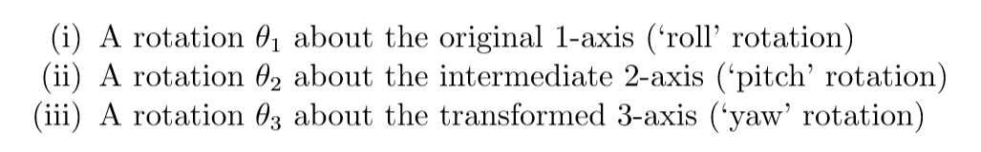

Alternate Rotation Representations
Euler Angles

Slide 29


Euler Angles
Gimbal Lock

Slide 30






Angle-Axis
Angle-Axis aka Rotation vector
Rotation Axis is represent by a vector R
Rotation Angle is represent by the longitude of R

Slide 31




Quaternions
Quaternions is represent by a scalar part and a virtual part
=

Slide 32




Quaternions

Slide 33



Quaternions

Slide 34





Quaternions

Slide 35



Transform Matrix

Slide 36




Transform Matrix

Slide 37
PART 3
Lie Group and Lie Algebra

Slide 38
Lie groups
In mathematics, a group is a set of elements together with an operation that combines any two of its elements to form a third element also in the set, while satisfying four conditions called the group axioms, namely closure, associativity, identity, and invertibility.
A Lie group is a group that is also a diﬀerential manifold, with the property that the group operations are smooth.

Slide 39

Special Orthogonal and Special Euclidean Groups
The CCT = 1 orthogonality condition is needed to impose six constraints on the nine-parameter rotation matrix, thereby reducing the number of degrees of freedom to three.
detC = 1 ensures that we have a proper rotation

Slide 40

Special Orthogonal and Special Euclidean Groups
Although the set of all matrices can be shown to be a vectorspace, SO(3) is not a valid subspace

Slide 41

Special Orthogonal and Special Euclidean Groups

Slide 42

Property

Slide 43


Lie Algebras

Slide 44



Lie algebra associated with SO(3)

Slide 45



Lie algebra associated with SE(3)

Slide 46


Slide 47


Slide 48


Exponential Map
It turns out that the exponential map is the key to relating a matrix Lie group to its associated Lie algebra

Slide 49

Rotations

Slide 50





Let φ = φa where φ = |φ| is the angle of rotation and a = φ/φ is the unit-length axis of rotation. For the matrix exponential, we then have

Slide 51







Slide 52

Example of the relationship between the Lie group and Lie algebra for the case of rotation constrained to the plane. In a small neighbourhood around the θvi = 0 point, the vectorspace associated with the Lie algebra is a line tangent to the circle.

Slide 53

Poses

Slide 54




Slide 55




Slide 56


Derivation and perturbation scheme
Lie group is not close for additions, so is not possible to define derivation for rotation
Possible solutions:
Use additions on lie algebra to replace
Use exponentials map and reverse
A basic question

Slide 57

Baker-Campbell-Hausdorff

Slide 58

Rotations

Slide 59


Slide 60





Derivation and perturbation scheme
Use BCH linear approximation , we can define derivation
Think about a basic derivation of a point after rotation

Slide 61

Derivation

Slide 62


Perturbation

Slide 63
PART 4
Sensor Model

Slide 64



Odometry Modeling
Differential Platform

Slide 65





Odometry Modeling
Omni Platform
Translation on x
Translation on y
Rotation on z

Slide 66

Odometry Modeling
combination

Slide 67



Mecanum Platform
V is$vector$
$${\left[v_{x }v_{y}{ ω}_{v}\right]}^{T}$$
[Ω] = [ω1 ω2 ω3 ω4] represent four rotation velocity of each wheels
[Ω](r)=[R][V]
R =$\left[\begin{matrix}1 & −1 & −K \\ 1 & 1 & −K \\ 1 & −1 & K \\ 1 & 1 & K\end{matrix}\right]$
[F][ Ω](r)=[V]
F= $\left[\begin{matrix}1/4 & 1/4 & 1/4 & 1/4 \\ −1/4 & 1/4 & −1/4 & 1/4 \\ −1/(4K) & −1/(4K) & 1/(4K) & 1/(4K)\end{matrix}\right]$

Slide 68



Odometry
Nosie

Slide 69

LIDAR Depth Sensor

Slide 70





Camera Model
Imaging plane to pixel plane
Intrinsic

Slide 71


Camera Model
Extrinsic

Slide 72



Camera Model
Stereo Camera Model
Baseline：central distance between two camera
Pixels geometry ：
thus

Slide 73
PART 5
Parameter Filter and Non-Parameter Filter

Slide 74


Bayes Filter

Slide 75



Bayes Filter
Definition of the belief
The prediction belief

Slide 76



Slide 77


Slide 78













Slide 79

Kalman Filter
It is a Bayes filter
Estimator for the linear Gaussian case
Optimal solution for linear models and Gaussian distributions
The Kalman filter assumes a linear transition and observation model
Zero mean Gaussian noise

Slide 80


Slide 81



Slide 82


Slide 83


Slide 84


Slide 85


Slide 86


Slide 87


Slide 88


Non-Linear Function

Slide 89

Non-Gaussian Distributions

Slide 90

EKF Linearization: First Order Taylor Expansion

Slide 91

Jacobian Matrix

Slide 92

Linearized Motion Model

Slide 93

Linearized Observation Model

Slide 94

Extended Kalman Filter Algorithm

Slide 95

Extended Information Filter

Slide 96

Extended Information Filter

Slide 97

Dual Representation

Slide 98

Marginalization and Conditioning

Slide 99

Information Filter Algorithm

Slide 100

Complexity

Slide 101




非线性最小二乘
这里 ，f 为任意函数
先考虑简单的问题：
当 f 很简单时：
解： 将得到极值点或鞍点，比较这些解即可
当 f 复杂时：
df/dx难求，或df/dx=0很难解
使用迭代方式求解

Slide 102

非线性最小二乘
迭代方式：
问题：如何确定这个增量？

Slide 103



非线性最小二乘
确定增量的方法（即梯度下降策略）：一阶的或二阶的
泰勒展开：
若只保留一阶梯度：
称为最速下降法（Steepest Method）
$$\min_{Δx}{‖f\left(x\right)‖}_{2}^{2}+JΔx$$
增量的方向：

Slide 104



非线性最小二乘
若保留二阶梯度：
则得到（令上式关于 的导数为零）：
该方法又称为牛顿法
$$Δx$$

Slide 105

非线性最小二乘
最速下降法和牛顿法虽然直观，但实用当中存在一些缺点
最速下降法会碰到zigzag问题（过于贪婪）
牛顿法迭代次数少，但需要计算复杂的Hessian矩阵
能否回避Hessian的计算？
Gauss-Newton
Levenberg-Marquadt

Slide 106






非线性最小二乘
Gauss-Newton
一阶近似 f(x)：
平方误差变为：
令关于 导数为零：
$$Δx$$

Slide 107


非线性最小二乘
G-N用J的表达式近似了H
步骤：

Slide 108
特征点提取与匹配
经典SLAM模型中以位姿——路标（Landmark）来描述SLAM过程
路标是三维空间中固定不变的点，能够在特定位姿下观测到
数量充足，以实现良好的定位
较好的区分性，以实现数据关联
在视觉SLAM中，可利用图像特征点作为SLAM中的路标

Slide 109

特征点提取与匹配
特征点：图像当中具有代表性的部分
可重复性
可区别性
高效
本地
特征点的信息
位置、大小、方向、评分等——关键点
特征点周围的图像信息——描述子（Descriptor）
例子：SIFT/SURF/ORB 见OpenCV features2d模块
特征描述应该在光照、视角发生少量变化时仍能保持一致

Slide 110


特征点提取与匹配
例子：ORB特征
关键点：Oriented FAST
描述：BRIEF
FAST
连续N个点的灰度有明显差异
Oriented FAST
在FAST基础上计算旋转

Slide 111

特征点提取与匹配
BRIEF
BRIEF-128：在特征点附近的128次像素比较
ORB：旋转之后的BRIEF描述
BRIEF是一种二进制描述，需要用汉明距离度量
BRIEF的比较pattern

Slide 112

特征点提取与匹配
特征匹配
通过描述子的差异判断哪些特征为同一个点
暴力匹配：比较图1中每个特征和图2特征的距离
加速：快速最近邻（FLANN）

Slide 113









2D-2D 对极几何
世界坐标：
以第一个图为参考系，投影方程：
使用归一化坐标（去掉内参）：
齐次关系：
两侧左乘：
再一步左乘：
对极约束：
带内参的形式：

Slide 114

2D-2D 对极几何
$$O_{1},O_{2},P$$
对极约束刻画了 共面的关系
定义：
Essential矩阵
Fundamental矩阵
在内参已知的情况下，可以使用E
两步计算位姿：
由匹配点计算E
由E恢复R,t
对极约束的性质：
乘任意非零常数依然满足
E共五个自由度
当成普通矩阵的话，有八个自由度
可用八点法求解

Slide 115




2D-2D 对极几何
八点法求E
将E看成通常3x3的矩阵，去掉因子后剩八个自由度
一对匹配点带来的约束：
向量形式：
八对点构成方程组

Slide 116



2D-2D 对极几何
从E计算R, t：奇异值分解
四个可能的解，但只有一个深度为正

Slide 117


2D-2D 对极几何
SVD过程中：
取 因为E的内在性质要求它的奇异值为
最少可使用五个点计算R,t，称为五点法
但需要利用E的非线性性质，原理较复杂

Slide 118
2D-2D 对极几何
八点法的讨论
用于单目SLAM的初始化
尺度不确定性：归一化 t 或特征点的平均深度
纯旋转问题：t=0 时无法求解
多于八对点时：最小二乘

Slide 119

3D-2D PnP
已经3D点的空间位置和相机上的投影点，求相机的旋转和平移（外参）
代数的解法/优化的解法
代数的
DLT
P3P
EPnP/UPnP/…
优化的：Bundle Adjustment

Slide 120






3D-2D PnP
PnP的优化解法：Bundle Adjustment
最小化重投影误差（Minimizing a reprojection error）
投影关系：
定义重投影误差并取最小化：
$$ξ$$
$$K$$
$$u$$
P：3d点， 相机位姿 内参 投影

Slide 121








3D-2D PnP
$$e_{i}=u_{i}−\frac{1}{s_{i}}Kexp\left(ξ^{^}\right)P_{i}$$
线性化和雅可比
考虑单个投影点误差：
线性化：
雅可比的形式？
$$e_{i}(x+Δx)≈e_{i}\left(x\right)+J\left(x\right)Δx$$
P’为P在相机坐标系下的坐标：
对P’进行投影：
第一项：

Slide 122



3D-2D PnP
第二项：
非齐次形式：
两项相乘：

Slide 123


3D-2D PnP
也可以对3D点求导：
$$e_{i}=u_{i}−\frac{1}{s_{i}}Kexp\left(ξ^{^}\right)P_{i}$$

Slide 124




3D-3D ICP
给定配对好的两组3D点，求其旋转和平移，可用迭代最近点（Iterative Closest Point，ICP求解）
设：
运动关系：
同样定义误差项：
以及最小二乘问题：

Slide 125



3D-3D ICP
稍加推导：
定义质心：
改写目标函数：
交叉项部分求和为零 =>

Slide 126

3D-3D ICP
目标函数简化为：
最小化第一项，然后取t，使得后一项为零。
左侧项如何求？
只和R有关
和R,t都有关

Slide 127







3D-3D ICP
推导：
最右一项：
SVD解法：
旋转的求取
定义去质心坐标：
最小化：

Slide 128



MAP
• Metric Map
• Topological Map
• Semantic Map

Slide 129


Occupancy Grid Mapping

Slide 130

Occupancy Grid Mapping

Slide 131


Occupancy Grid Mapping

Slide 132

Occupancy Grid Mapping

Slide 133

Occupancy Grid Mapping

Slide 134

Occupancy Grid Mapping

Slide 135


Occupancy Grid Mapping

Slide 136

Occupancy Grid Mapping

Slide 137

Occupancy Grid Mapping

Slide 138

Occupancy Grid Mapping

Slide 139

Occupancy Grid Mapping

Slide 140

Occupancy Grid Mapping

Slide 141

Occupancy Grid Mapping

Slide 142

Graph-Based SLAM
▪▪ Constraints connect the poses of the robot while it is moving
▪▪ Constraints are inherently uncertain
Robot pose
Constraint

Slide 143
Graph-Based SLAM
▪▪ Observing previously seen areas generates constraints between non- successive poses
Robot pose
Constraint

Slide 144
Idea of Graph-Based SLAM
▪▪ Use a graph to represent the problem
▪▪ Every node in the graph corresponds to a pose of the robot during mapping
▪▪ Every edge between two nodes corresponds to a spatial constraint between them
▪▪ Graph-Based SLAM: Build the graph and find a node configuration that minimize the error introduced by the constraints

Slide 145

Graph-Based SLAM in a Nutshell
▪▪ Every node in the graph corresponds to a robot position and a laser measurement
▪▪ An edge between two nodes represents a spatial constraint between the nodes
KUKA Halle 22, courtesy of P. Pfaff

Slide 146

Graph-Based SLAM in a Nutshell
▪▪ Every node in the graph corresponds to a robot position and a laser measurement
▪▪ An edge between two nodes represents a spatial constraint between the nodes
KUKA Halle 22, courtesy of P. Pfaff

Slide 147

Graph-Based SLAM in a Nutshell
▪▪ Once we have the graph, we determine the most likely map by correcting the nodes

Slide 148

Graph-Based SLAM in a Nutshell
▪▪ Once we have the graph, we determine the most likely map by correcting the nodes
… like this

Slide 149

Graph-Based SLAM in a Nutshell
▪▪ Once we have the graph, we determine the most likely map by correcting the nodes
… like this
▪▪ Then, we can render a map based on the known poses

Slide 150
The Overall SLAM System
▪▪ Interplay of front-end and back-end
▪▪ Map helps to determine constraints by reducing the search space
▪▪ Topic today: optimization
node positions
Graph Construction
(Front-End)
Graph Optimization
(Back-End)
raw data
graph (nodes & edges)

Slide 151




The Graph
▪▪ It consists of n nodes
▪▪ Each is a 2D or 3D transformation (the pose of the robot at time )
▪▪ A constraint/edge exists between the nodes and if…
ti

Slide 152

Create an Edge If… (1)
▪▪ …the robot moves from to
▪▪ Edge corresponds to odometry
The edge represents the
odometry measurement

Slide 153
Create an Edge If… (2)
▪▪ …the robot observes the same part of the environment from and from
x_{i}
x_{j}
Measurement from
Measurement from

Slide 154


Create an Edge If… (2)
▪▪ …the robot observes the same part of the environment from and from
▪▪ Construct a virtual measurement
about the position of seen from
Edge represents the position of seen from based on the observation

Slide 155


Transformations
▪▪ Transformations can be expressed using homogenous coordinates
▪▪ Odometry-Based edge
▪▪ Observation-Based edge
How node i sees node j

Slide 156

The Edge Information Matrices
▪▪ Observations are affected by noise
▪▪ Information matrix for each edge to encode its uncertainty
▪▪ The “bigger” , the more the edge “matters” in the optimization
Questions
▪▪ What do the information matrices look like in case of scan-matching vs. odometry?
▪▪ What should these matrices look like when moving in a long, featureless corridor?

Slide 157


Pose Graph
observation of from
edge
error
nodes according to the graph

Slide 158

Pose Graph
observation of from
edge
error
nodes according to the graph
▪▪ Goal:

Slide 159

Least Squares SLAM
▪▪ This error function looks suitable for least squares error minimization

Slide 160


Least Squares SLAM
▪▪ This error function looks suitable for least squares error minimization
Question:
▪▪ What is the state vector?
One block for each node of the graph
▪▪ Specify the error function!

Slide 161



The Error Function
▪▪ Error function for a single constraint
measurement
x_{j} referenced w.r.t. x_{i}
▪▪ Error as a function of the whole state vector
▪▪ Error takes a value of zero if

Slide 162
Gauss-Newton: The Overall Error Minimization Procedure
▪▪ Define the error function
▪▪ Linearize the error function
▪▪ Compute its derivative
▪▪ Set the derivative to zero
▪▪ Solve the linear system
▪▪ Iterate this procedure until convergence

Slide 163


Linearizing the Error Function
▪▪ We can approximate the error functions around an initial guess via Taylor expansion
with

Slide 164




Derivative of the Error Function
▪▪ Does one error term depend on all state variables?
No, only on and
▪▪ Is there any consequence on the
structure of the Jacobian?
Yes, it will be non-zero only in the rows corresponding to and

Slide 165



Jacobians and Sparsity
▪▪ Error depends only on the two parameter blocks and
▪▪ The Jacobian will be zero everywhere except in the columns of and

Slide 166




Consequences of the Sparsity
▪▪ We need to compute the coefficient vector and matrix :
▪▪ The s p arse structure of will result in a sparse structure of
▪▪ This structure reflects the adjacency matrix of the graph

Slide 167

Illustration of the Structure
Non-zero only at x_{i} and x_{j}

Slide 168

Illustration of the Structure
Non-zero only at x_{i} and x_{j}
Non-zero on the main diagonal at x_{i} and x_{j}

Slide 169
Illustration of the Structure
Non-zero only at x_{i} and x_{j}
Non-zero on the main diagonal at x_{i} and x_{j}
... and at the blocks ij,ji

Slide 170


Illustration of the Structure
+
+ … +
+
+ … +

Slide 171



Consequences of the Sparsity
▪▪ An edge contributes to the linear system via and
▪▪ The coefficient vector is:
▪▪ It is non-zero only at the indices corresponding to and

Slide 172

Consequences of the Sparsity
▪▪ The coefficient matrix of an edge is:
▪▪ Non-zero only in the blocks relating i,j

Slide 173


The Linear System
▪▪ Vector of the states increments:
▪▪ Coefficient vector:
▪▪ System matrix:

Slide 174



Building the Linear System
For each constraint:
▪▪ Compute error
▪▪ Compute the blocks of the Jacobian:
▪▪ Update the coefficient vector:
▪▪ Update the system matrix:

Slide 175

Algorithm

Slide 176
Robot Mapping
Short Introduction to Particle Filters and Monte Carlo Localization

Slide 177

Gaussian Filters
▪▪ The Kalman filter and its variants can only model Gaussian distributions

Slide 178
Motivation
▪▪ Goal: approach for dealing with
arbitrary distributions

Slide 179




Key Idea: Samples
▪▪ Use multiple samples to represent arbitrary distributions
samples
4

Slide 180


Particle Set
▪▪ Set of weighted samples
state hypothesis
importance weight
▪▪ The samples represent the posterior

Slide 181





Particles for Approximation
▪▪ Particles for function approximation
▪▪ The more particles fall into a region, the higher the probability of the region
How to obtain such samples?

Slide 182


Closed Form Sampling is Only
Possible for a Few Distributions
▪▪ Example: Gaussian
How to sample from other distributions?

Slide 183

Importance Sampling Principle
▪▪ We can use a different distribution g
to generate samples from f
▪▪ Account for the “differences between
g and f ” using a weight w = f / g
▪▪ target f
▪▪ proposal g
▪▪ Pre-condition:
f(x)>0 →→ g(x)>0
8
8

Slide 184
Importance Sampling Principle

Slide 185
Particle Filter
▪▪ Recursive Bayes filter
▪▪ Non-parametric approach
▪▪ Models the distribution by samples
▪▪ Prediction: draw from the proposal
▪▪ Correction: weighting by the ratio of target and proposal
The more samples we use, the better is the estimate!

Slide 186






Particle Filter Algorithm
Sample the particles using the proposal distribution
Compute the importance weights
▪▪ Resampling: Draw sample probability and repeat
with times

Slide 187

Particle Filter Algorithm

Slide 188


Monte Carlo Localization
▪▪ Each particle is a pose hypothesis
▪▪ Proposal is the motion model
▪▪ Correction via the observation model

Slide 189

Particle Filter for Localization

Slide 190

initialization

Slide 191

observation

Slide 192
resampling

Slide 193

motion update

Slide 194

measurement
23

Slide 195

weight update
24

Slide 196

resampling
25

Slide 197

motion update
26

Slide 198

measurement
27

Slide 199

weight update
28

Slide 200

resampling
29

Slide 201

motion update
30

Slide 202

measurement
31

Slide 203

weight update
32

Slide 204

resampling
33

Slide 205

motion update
34

Slide 206

measurement

